Slide 1

HOME
ABOUT US
CONTACT US
LOGIN
REGISTER
Career Guidence System Using Machine Learning
Get Started

Slide 2



Login
Username
Password
Login
Forgot Password?
Sign up.

Slide 3
Sign Up
First Name
Last Name
Username
Email
New Password
Confirm Password
Submit
Login to existing account

Slide 4


Please Sign-in to your account.
Username
Password
Forgot Password?
SIGN IN
New to our platform. Create an account.

Slide 5
Create your account by providing the details.
First Name
Last Name
Username
Email
New Password
Confirm Password
Submit
Login to existing account

Slide 6


Slide 7
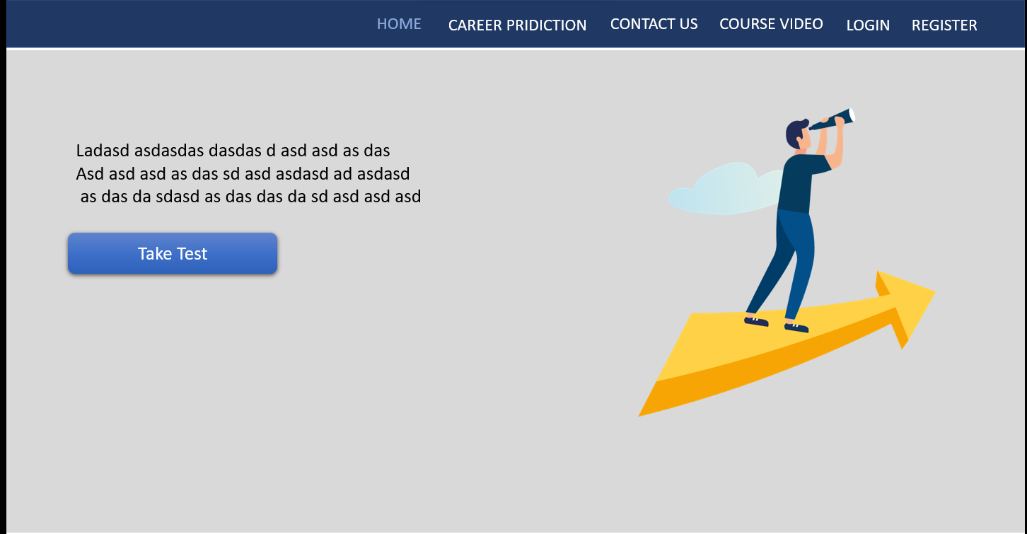

Slide 8
Home
Prediction
Courses
Contact Us
Answer the following questions
1) First Question :
A
B
C
D
2) Second Question :
A
B
C
D
3) Third Question :
A
B
C
D
4) Forth Question :
A
B
C
D
5) Fifth Question :
A
B
C
D
And some other sort of questions
Submit
Clear

Slide 9
HOME
SERVICES
ABOUT US
Want to Know More?
Reach Out to us!
Contact Us
First name
Contact Us
First name
Last name
Email
Description
Submit

